Slide 1

House hunting the data science way

Slide 2
The goal is to turn data into information, and information into insight
- Carly Fiorina, CEO of HP from 1999-2005

Slide 3
Objective
My girlfriend and I are planning to buy a house soon. We are looking at purchasing a house either near her parents or mine (Tampines or Bukit Panjang). We are also looking at purchasing flats in other towns with recent MRT developments like Punggol and Woodlands.
So we wanted to use data to make better decision and give some insights into the resale market, and whether it’s the right time to purchase a flat now.
Some criteria we are looking out for – 4 room flat, relatively less crowded area, less than SGD $400k.
Notes:
Icons made by <a href="https://www.flaticon.com/authors/freepik" title="Freepik">Freepik</a> from <a href="https://www.flaticon.com/" title="Flaticon"> www.flaticon.com</a>

Slide 4
Data set 1
The dataset is from https://data.gov.sg/dataset/hdb-resale-price-index and https://data.gov.sg/dataset/resale-transaction-by-flat-type-based-on-registered-cases
Description: The HDB resale price index tracks the overall price movement of the public residential market.

Slide 5
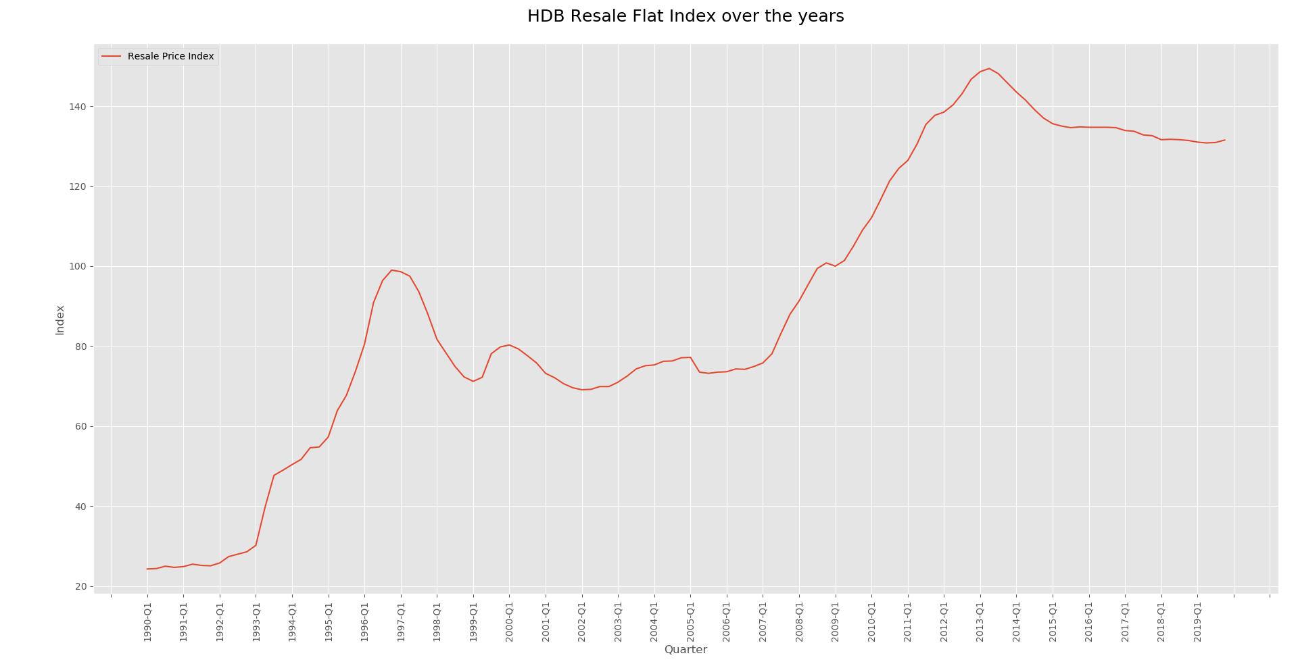

Slide 6
Analysis for graph 1
The resale price index indicates that the market is relatively stable now. It would be a good time to purchase a flat in the resale market as there is no volatility expected now.
Analysis: Property bubble not expected, safe to buy a house.

Slide 7
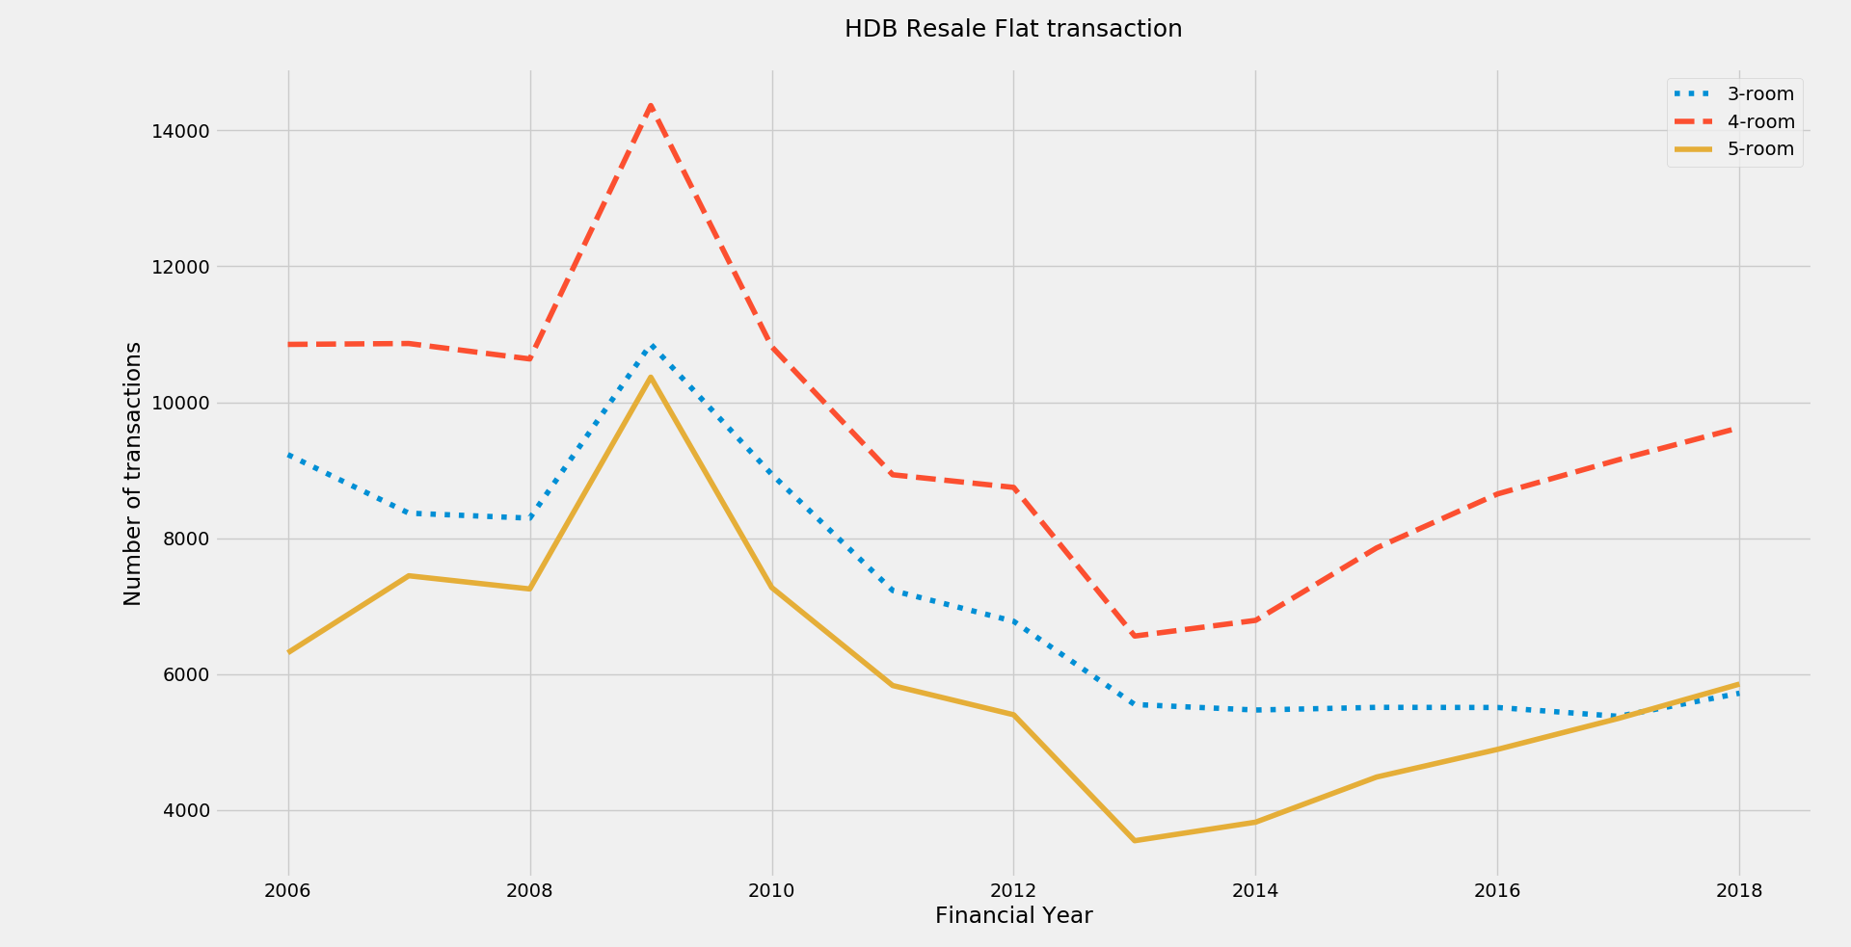

Slide 8
Analysis for graph 1.1
Number of transaction for 4-room flats are the highest. This could be attributed to people upgrading to 5-rooms once the 5 year mandatory no-sale period impose by the government. Extrapolating the data, it means the number of transaction will increase 2019 onwards.
Analysis: 4-room flats display the highest number of transaction. This would indicate that it might be easy to find a good house since many will be up for sale this period.

Slide 9
Data set 2
The dataset is from https://data.gov.sg/dataset/land-area-and-dwelling-units-by-town.
Description: The dataset plots the land area with residential units by town. There is a column for the expected maximum number of units in each town.
SKLearn was used to graph the regression line.

Slide 10
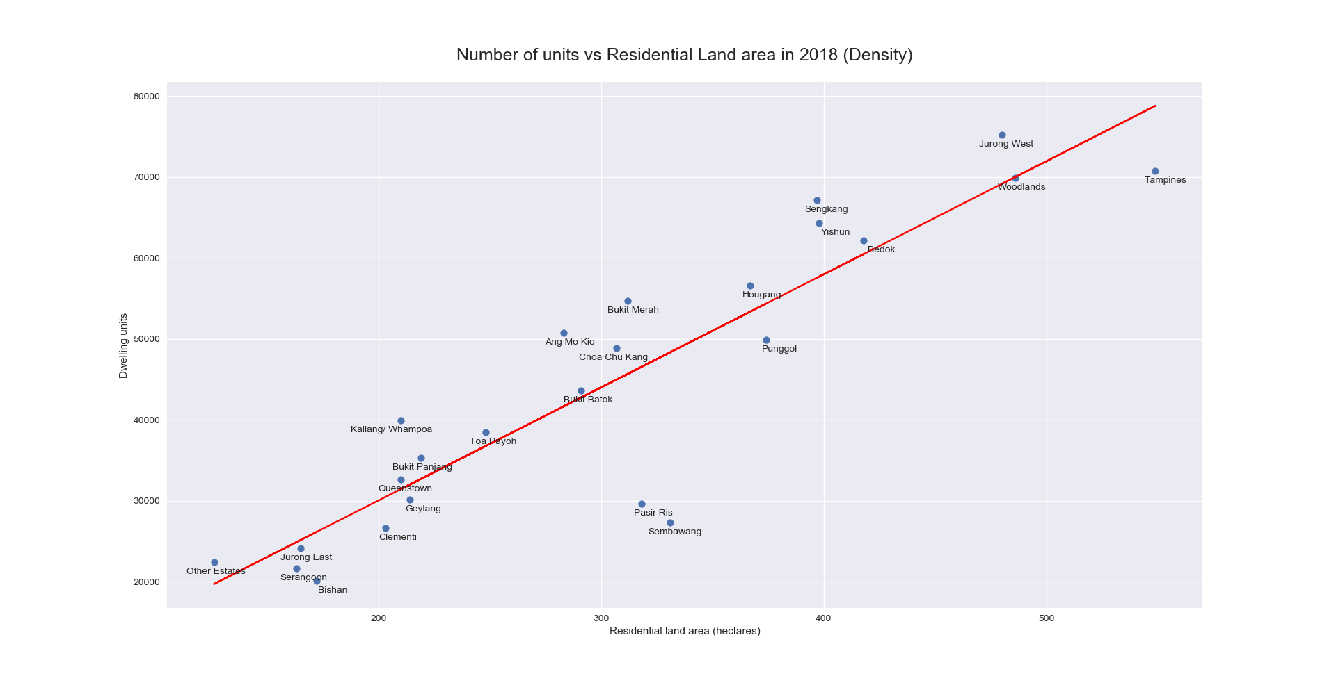

Slide 11
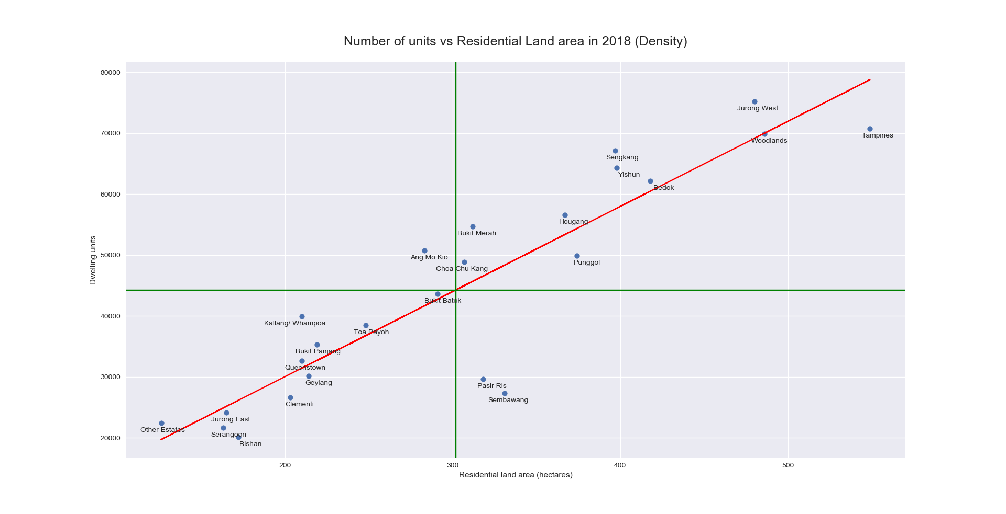
Analysis for graph 2
The graph is divided into 4 quadrants. The linear line indicates excellent urban planning by government. The towns in Quadrant 2 and 3 are recommended as the land area correlates well with unit number. Quadrant 1 is not recommended because the town might be “crowded’. Quadrant 4 is the best as there is more land than units as compared to the rest of the towns.
Analysis: The towns we selected are close to the regression line. Pasir Ris and Sembawang are good areas but the lack of connectivity kept us away from choosing the units.
1
2
3
4

Slide 12
Data set 3
The dataset is from https://data.gov.sg/dataset/resale-flat-prices
Description: The dataset includes resale flat prices for units ranging from 1 room to 5 room in various towns.
Pygal was used with lxml to display an interactive graph.

Slide 13
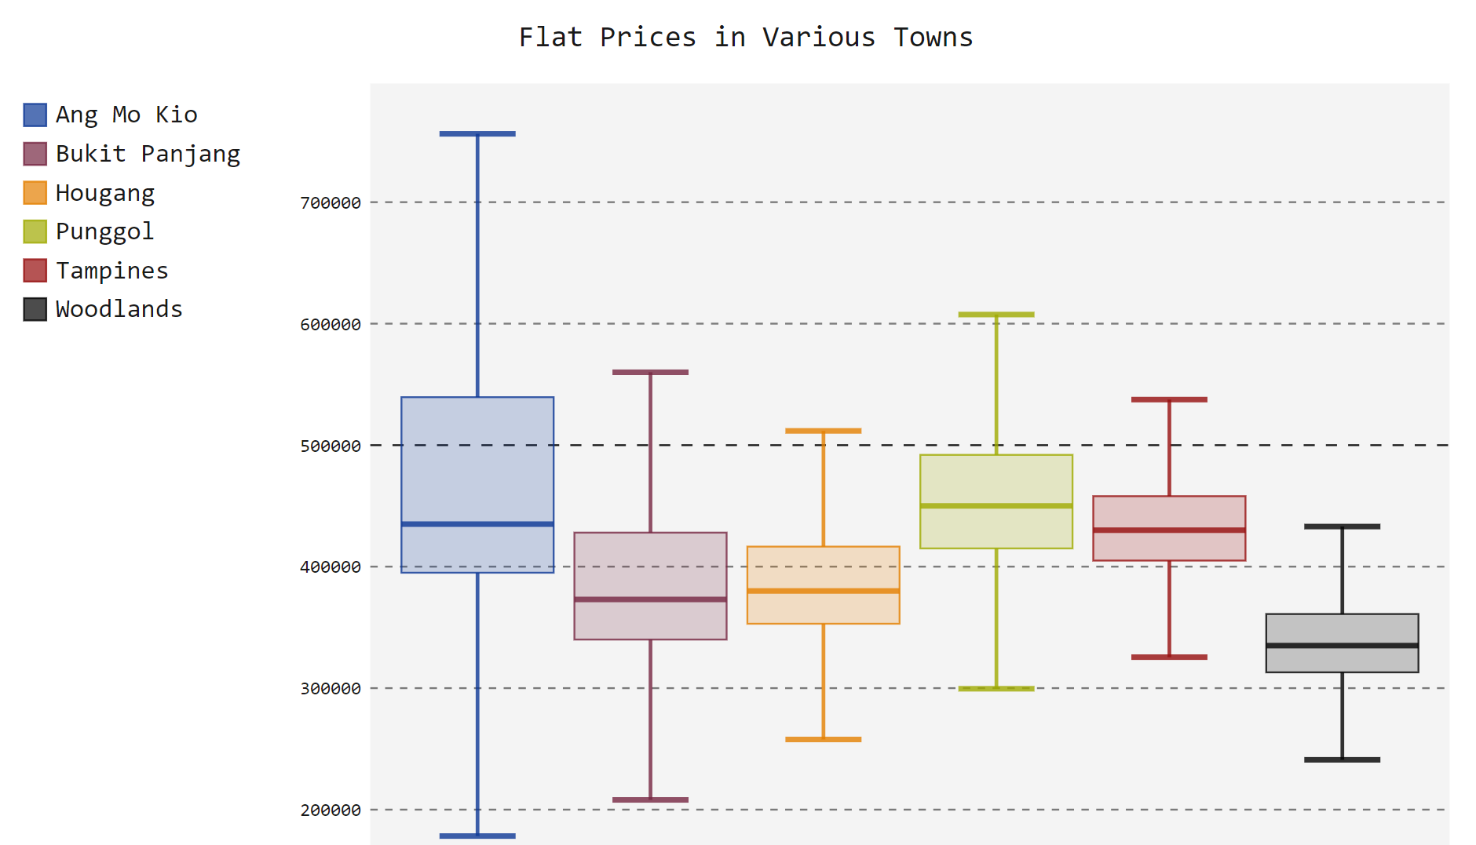

Slide 14

Analysis for graph 3
We selected 6 towns from our previous scatterplot.Woodlands seem attractive because it’s median price is below 400K and there are new MRT developments there. Bukit Panajng is also attractive given the downtown line. Tampines and Ang Mo Kio are too expensive.
Analysis: Based on this graph alone, the woodlands and Bukit Panjang were ruled out. We would like to understand what others think about this units.

Slide 15
Data set 4
The dataset is from https://data.gov.sg/dataset/hdb-track-record
Description: This dataset describes the number of transaction done by each saleperson for houses in various towns.
Pygal was used in this graph. Data was stored in mysql server and was extracted using pandas.

Slide 16
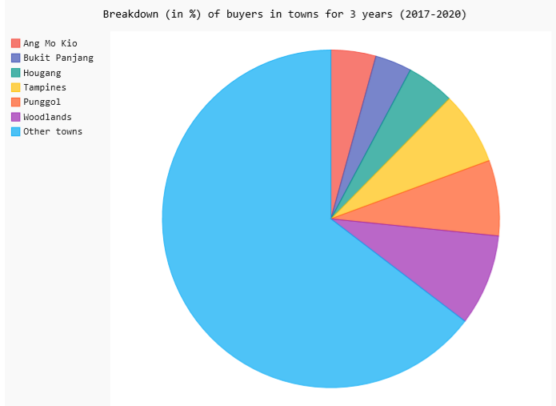
Analysis for graph 4
The number of buyers for woodlands is relatively high as compared to the other towns. There is a huge number of buyers in Punggol and tampines too given both the towns are 2nd and 3rd after woodlands. There is relatively low buyers in Bukit Panjang.

Slide 17
Conclusion
My girlfriend and I are strongly looking at woodlands now given that the area fits our budget and ticks most of our checkboxes. Looking at the resale market, it is expected to be relatively stable.

